Slide 1
Discrete Structures
CH 01: Logic and Proofs

Slide 2
Content
The Foundations: Logic and Proofs
Propositional Logic
Applications of Propositional Logic
Propositional Equivalences
Predicates and Quantifiers
Nested Quantifiers
Rules of Inference
Introduction to Proofs
Proof Methods and Strategy

Slide 3

Propositional Logic
Logic rules are used to distinguish between valid and invalid mathematical arguments.
A proposition is a declarative sentence (a sentence that declares a fact) that is either true or false, but not both.
Propositions are the basic building blocks of logic.

Slide 4
Propositional Logic
EXAMPLE 1: All the following declarative sentences are propositions.
Proposition | T/F
Washington, D.C., is the capital of the United States of America | True
Qena is the capital of Canada | False
1 + 1 = 2 | True
2 + 2 = 3 | False

Slide 5
Propositional Logic
EXAMPLE 2: Some sentences that are not propositions.
Proposition
What time is it? | not declarative sentence
Read this carefully. | not declarative sentence
x + 1 = 2. | neither true nor false
x + y = z. | neither true nor false

Slide 6
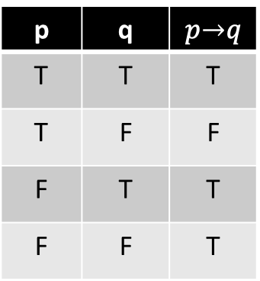
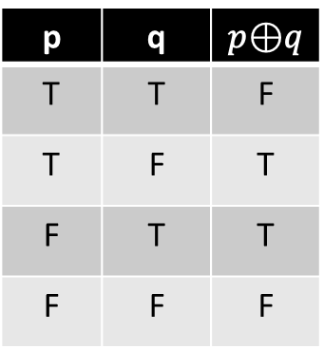
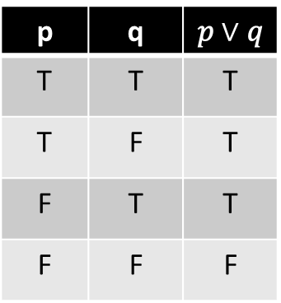
Propositional Logic
Logical Operations
Negation (¬𝑝)
Conjunction ($p ∧ q$)
Conjunction (𝑝 ∧ 𝑞)
Disjunction ($p ∨ q$)
Disjunction (𝑝 ∨ 𝑞)
Conditional ($p → q$)
Conditional (𝑝 → 𝑞)
Exclusive ($p ⊕ q$)
Exclusive (𝑝 ⊕ 𝑞)
p | q | 𝑝 ∧ 𝑞
T | T | T
T | F | F
F | T | F
F | F | F
p | q | 𝑝 $∨$ 𝑞
T | T | T
T | F | T
F | T | T
F | F | F
p | q | 𝑝$⊕$𝑞
T | T | F
T | F | T
F | T | T
F | F | F
p | q | 𝑝$→$𝑞
T | T | T
T | F | F
F | T | T
F | F | T
p | ¬𝑝
T | F
F | T

Slide 7



Propositional Logic
EXAMPLE 7: Let $p$ be the statement “Maria learns discrete mathematics” and $q$ the statement “Maria will find a good job.” Express the statement $p → q$as a statement in English.
Solution 7: “If Maria learns discrete mathematics, then she will find a good job.”
The statement “If Juan has a smartphone, then 2 + 3 = 5” is true from the definition of a conditional statement, because its conclusion is true.
The truth value of the hypothesis does not matter then.
The conditional statement “If Juan has a smartphone, then 2 + 3 = 6” is true if Juan does not have a smartphone, even though 2 + 3 = 6 is false.
$$T →T=T$$
$$T →F=F$$

Slide 8

Propositional Logic
EXAMPLE 8: What is the value of the variable $x$ after the statement $if 2 + 2 = 4 then x := x + 1$ if $x = 0$ before this statement is encountered?
Solution 8: Because $2 + 2 = 4$is true, the assignment statement $x := x + 1$ is executed. Hence, $x$ has the value $0 + 1 = 1$ after this statement is encountered.

Slide 9




Propositional Logic
Related conditional statements
CONVERSE
CONTRAPOSITIVE
INVERSE
$$p → q$$
$$q → p$$
$$¬q →¬p$$
$$¬p →¬q$$
Only the contrapositive always has the same truth value as $p → q$.

Slide 10
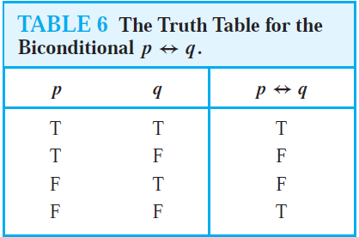

Propositional Logic
The biconditional statement $p ↔ q$is the proposition “p if and only if q.”
The biconditional statement $p ↔ q$ is true when $p$ and $q$ have the same truth values and is false otherwise.
Example 10: “You can take the flight if and only if you buy a ticket.”

Slide 11
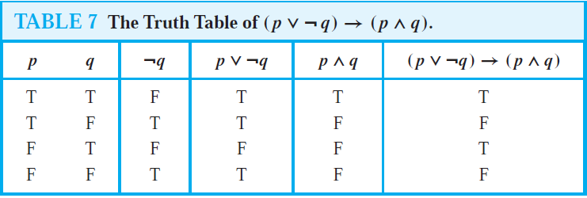

Propositional Logic
EXAMPLE 11: Construct the truth table of the compound proposition $(p ∨¬q) → (p ∧ q)$.

Slide 12
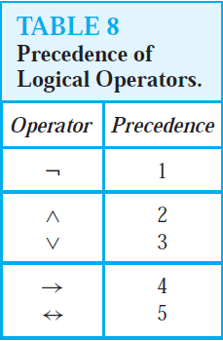
Propositional Logic
Precedence of Logical Operators

Slide 13
Exercises
1. Which of these sentences are propositions? What are the truth values of those that are propositions?
Sentence
Boston is the capital of Massachusetts
Miami is the capital of Florida
2 + 3 = 5
5 + 7 = 10
x + 2 = 11.
Answer this question

Slide 14
Exercises
1. Which of these sentences are propositions? What are the truth values of those that are propositions?
Sentence | Answer
Boston is the capital of Massachusetts | true proposition
Miami is the capital of Florida | false proposition
2 + 3 = 5 | true proposition
5 + 7 = 10 | false proposition
x + 2 = 11. | not a proposition
Answer this question | not a proposition

Slide 15
Exercises
6. What is the negation of each of these propositions?
Sentence
Jennifer and Teja are friends
There are 13 items in a baker’s dozen
Abby sent more than 100 text messages every day.
121 is a perfect square.

Slide 16
Exercises
6. What is the negation of each of these propositions?
Sentence | Answer
Jennifer and Teja are friends | Jennifer and Teja are not friends.
There are 13 items in a baker’s dozen | There are not 13 items in a baker’s dozen
Abby sent more than 100 text messages yesterday. | Abby sent fewer than 100 text messages yesterday
121 is a perfect square. | 121 is not a perfect square

Slide 17
Exercises
8. Suppose that Smartphone A has 256MB RAM and 32GB ROM, and the resolution of its camera is 8 MP; Smartphone B has 288 MB RAM and 64 GB ROM, and the resolution of its camera is 4 MP; and Smartphone C has 128 MB RAM and 32 GB ROM, and the resolution of its camera is 5 MP. Determine the truth value of each of these propositions.
Sentence
Smartphone B has the most RAM of these three smartphones.
Smartphone C has more ROM or a higher resolution camera than Smartphone B.
Smartphone B has more RAM, more ROM, and a higher resolution camera than Smartphone A.
If Smartphone B has more RAM and more ROM than Smartphone C, then it also has a higher resolution camera.
Smartphone A has more RAM than Smartphone B if and only if Smartphone B has more RAM than Smartphone A.

Slide 18
Exercises
8. Suppose that Smartphone A has 256MB RAM and 32GB ROM, and the resolution of its camera is 8 MP; Smartphone B has 288 MB RAM and 64 GB ROM, and the resolution of its camera is 4 MP; and Smartphone C has 128 MB RAM and 32 GB ROM, and the resolution of its camera is 5 MP. Determine the truth value of each of these propositions.
Sentence | Answer
Smartphone B has the most RAM of these three smartphones. | True
Smartphone C has more ROM or a higher resolution camera than Smartphone B. | True
Smartphone B has more RAM, more ROM, and a higher resolution camera than Smartphone A. | False
If Smartphone B has more RAM and more ROM than Smartphone C, then it also has a higher resolution camera. | False
Smartphone A has more RAM than Smartphone B if and only if Smartphone B has more RAM than Smartphone A. | False

Slide 19
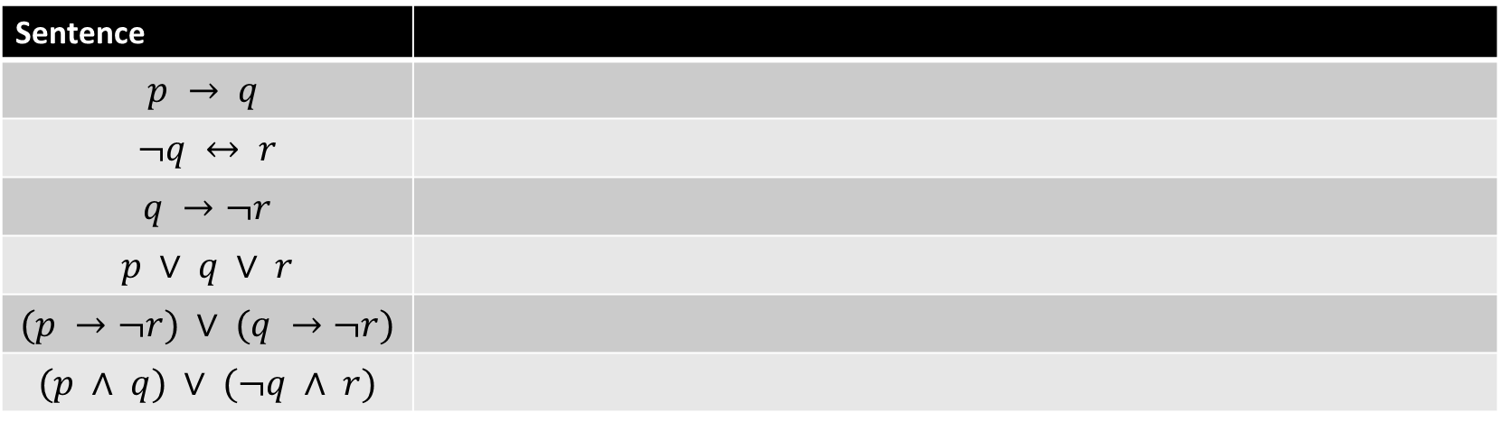

Exercises
14. Let $p, q$, and $r$ be the propositions
$p$ :You have the flu; $q$ :You miss the final examination; $r$ :You pass the course.
Express each of these propositions as an English sentence.
Sentence
$$p → q$$
$$¬q ↔ r$$
$$q →¬r$$
$$p ∨ q ∨ r$$
$$(p →¬r) ∨ (q →¬r)$$
$$(p ∧ q) ∨ (¬q ∧ r)$$

Slide 20
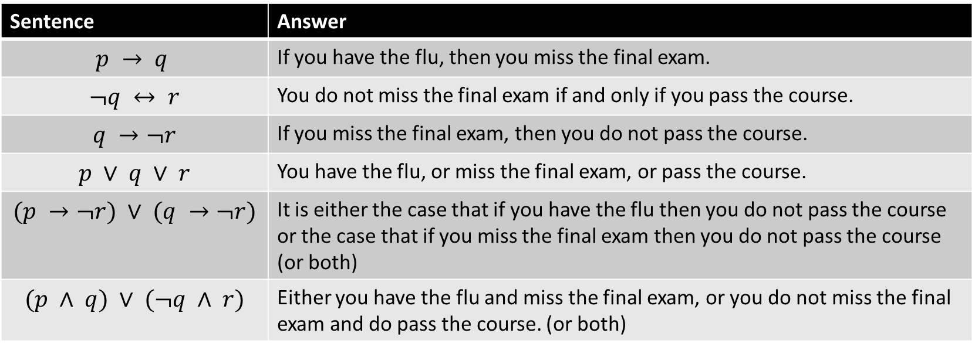
Exercises
14. Let $p, q$, and $r$ be the propositions
$p$ :You have the flu; $q$ :You miss the final examination; $r$ :You pass the course.
Express each of these propositions as an English sentence.
Sentence | Answer
$$p → q$$ | If you have the flu, then you miss the final exam.
$$¬q ↔ r$$ | You do not miss the final exam if and only if you pass the course.
$$q →¬r$$ | If you miss the final exam, then you do not pass the course.
$$p ∨ q ∨ r$$ | You have the flu, or miss the final exam, or pass the course.
$$(p →¬r) ∨ (q →¬r)$$ | It is either the case that if you have the flu then you do not pass the course or the case that if you miss the final exam then you do not pass the course (or both)
$$(p ∧ q) ∨ (¬q ∧ r)$$ | Either you have the flu and miss the final exam, or you do not miss the final exam and do pass the course. (or both)

Slide 21
Exercises
18. Determine whether these biconditionals are true or false.
Sentence
1 + 1 = 3 if and only if monkeys can fly
0 > 1 if and only if 2 > 1.

Slide 22
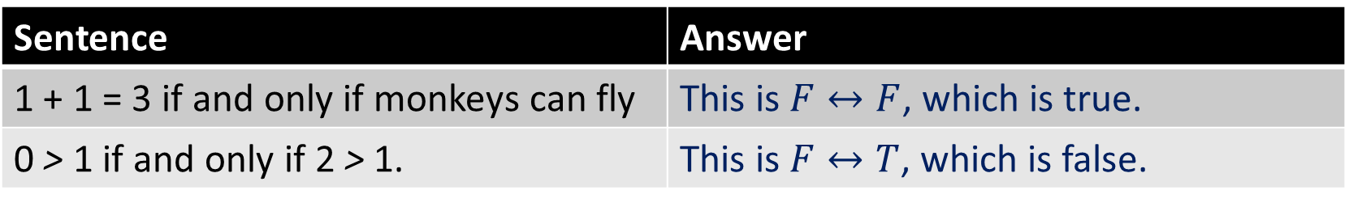
Exercises
18. Determine whether these biconditionals are true or false.
Sentence | Answer
1 + 1 = 3 if and only if monkeys can fly | This is $F↔F$, which is true.
0 > 1 if and only if 2 > 1. | This is $F↔T$, which is false.

Slide 23
Exercises
19. Determine whether each of these conditional statements is true or false.
Sentence
If 1 + 1 = 2, then 2 + 2 = 5.
If 1 + 1 = 3, then 2 + 2 = 4.

Slide 24
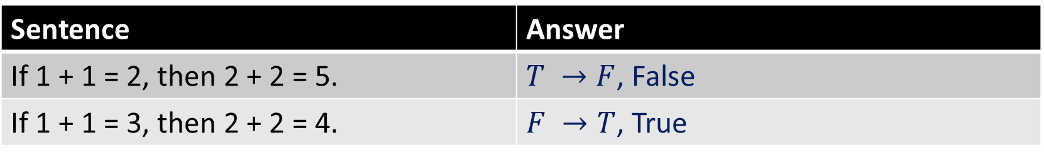
Exercises
19. Determine whether each of these conditional statements is true or false.
Sentence | Answer
If 1 + 1 = 2, then 2 + 2 = 5. | $T →F$, False
If 1 + 1 = 3, then 2 + 2 = 4. | $F →T$, True

Slide 25
Exercises
30. State the converse, contrapositive, and inverse of each of these conditional statements.
a) If it snows tonight, then I will stay at home.
b) I go to the beach whenever it is a sunny summer day.
c) When I stay up late, it is necessary that I sleep until noon.

Slide 26
Exercises
30. State the converse, contrapositive, and inverse of each of these conditional statements.
a) If it snows tonight, then I will stay at home.
b) I go to the beach whenever it is a sunny summer day.
c) When I stay up late, it is necessary that I sleep until noon.
Converse | Contrapositive | Inverse
If I stay home, then it will snow tonight | If I do not stay at home, then it will not snow tonight. | If it does not snow tonight, then I will not stay home.
Whenever I go to the beach, it is a sunny summer day. | Whenever I do not go to the beach, it is not a sunny summer day. | Whenever it is not a sunny day, I do not go to the beach.
If I sleep until noon, then I stayed up late. | If I do not sleep until noon, then I did not stay up late. | If I don’t stay up late, then I don’t sleep until noon.

Slide 27
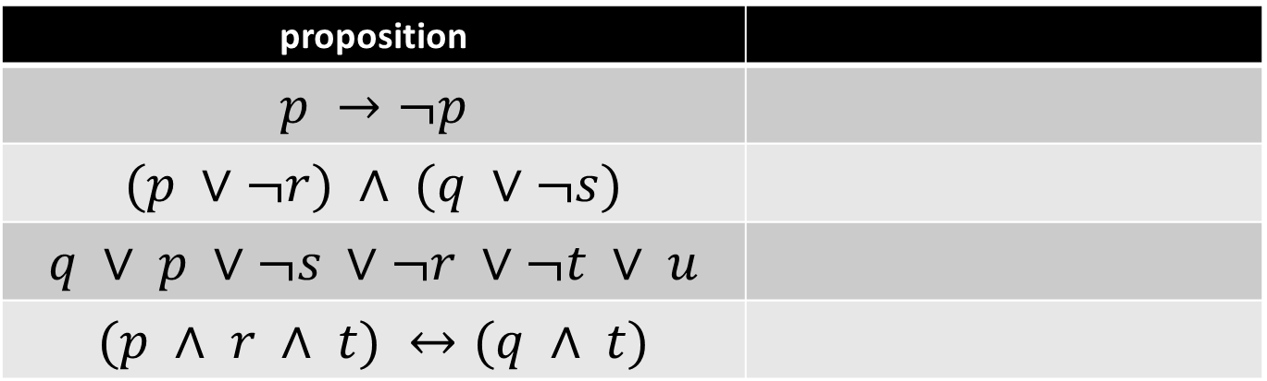
Exercises
31. How many rows appear in a truth table for each of these compound propositions?
proposition
$$p →¬p$$
$$(p ∨¬r) ∧ (q ∨¬s)$$
$$q ∨ p ∨¬s ∨¬r ∨¬t ∨ u$$
$$(p ∧ r ∧ t) ↔(q ∧ t)$$

Slide 28
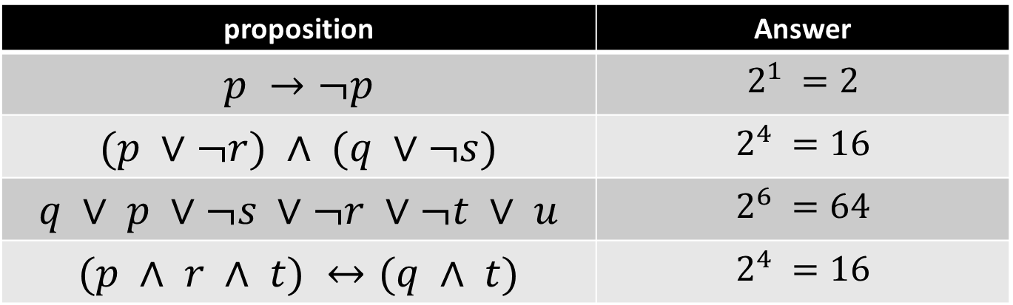
Exercises
31. How many rows appear in a truth table for each of these compound propositions?
proposition | Answer
$$p →¬p$$ | $$2^{1} =2$$
$$(p ∨¬r) ∧ (q ∨¬s)$$ | $$2^{4} =16$$
$$q ∨ p ∨¬s ∨¬r ∨¬t ∨ u$$ | $$2^{6} =64$$
$$(p ∧ r ∧ t) ↔(q ∧ t)$$ | $$2^{4} =16$$

Slide 29

Exercises
33. Construct a truth table for each of these compound propositions.
$p ∧¬p$
$p ∨¬p$
$\left(p ∨¬q\right)→ q$
$(p ∨ q) → (p ∧ q)$
$(p → q) ↔ (¬q →¬p)$
$(p → q) → (q → p)$

Slide 30
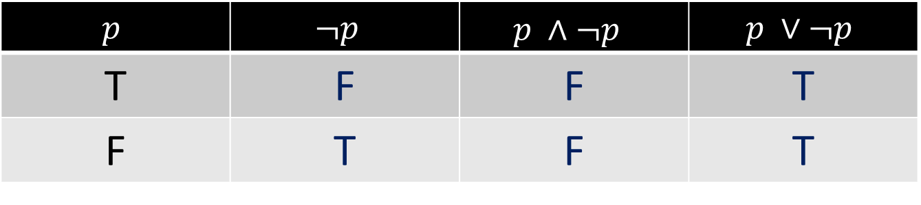

Exercises
33. Construct a truth table for each of these compound propositions.
$p ∧¬p$
$p ∨¬p$
$$p$$ | $$¬p$$ | $$p ∧¬p$$ | $$p ∨¬p$$
T | F | F | T
F | T | F | T

Slide 31
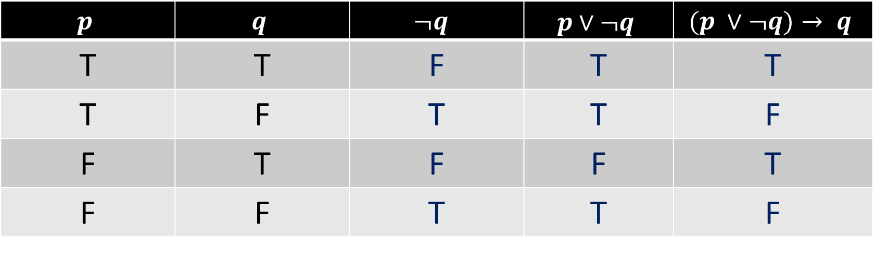

Exercises
33. Construct a truth table for each of these compound propositions.
$\left(p ∨¬q\right)→ q$
$$p$$ | $$q$$ | $$¬q$$ | $$p∨¬q$$ | $$(p ∨¬q)→ q$$
T | T | F | T | T
T | F | T | T | F
F | T | F | F | T
F | F | T | T | F

Slide 32
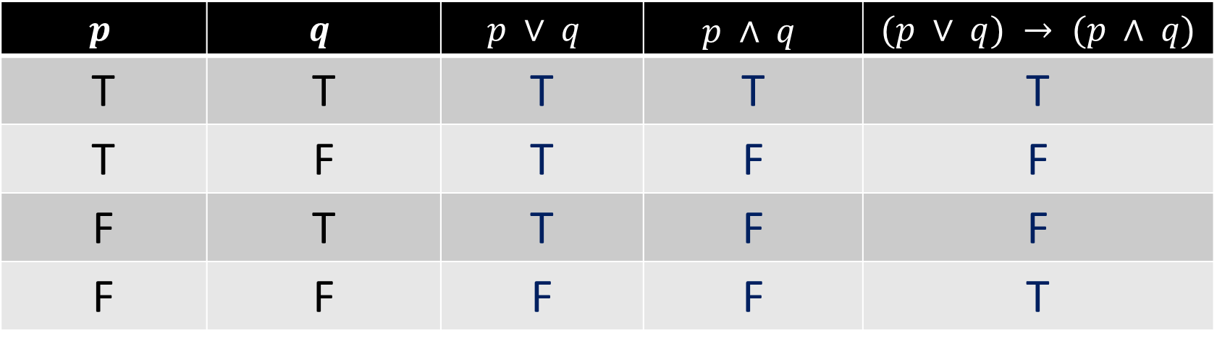

Exercises
33. Construct a truth table for each of these compound propositions.
$(p ∨ q) → (p ∧ q)$
$$p$$ | $$q$$ | $$p ∨ q$$ | $$p ∧ q$$ | $$(p ∨ q) → (p ∧ q)$$
T | T | T | T | T
T | F | T | F | F
F | T | T | F | F
F | F | F | F | T

Slide 33
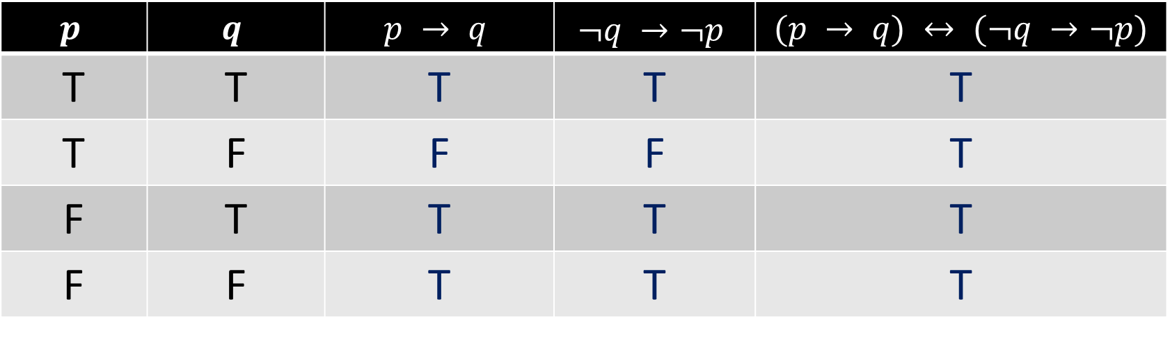

Exercises
33. Construct a truth table for each of these compound propositions.
$(p → q) ↔ (¬q →¬p)$
$$p$$ | $$q$$ | $$p → q$$ | $$¬q →¬p$$ | $$(p → q) ↔ (¬q →¬p)$$
T | T | T | T | T
T | F | F | F | T
F | T | T | T | T
F | F | T | T | T

Slide 34
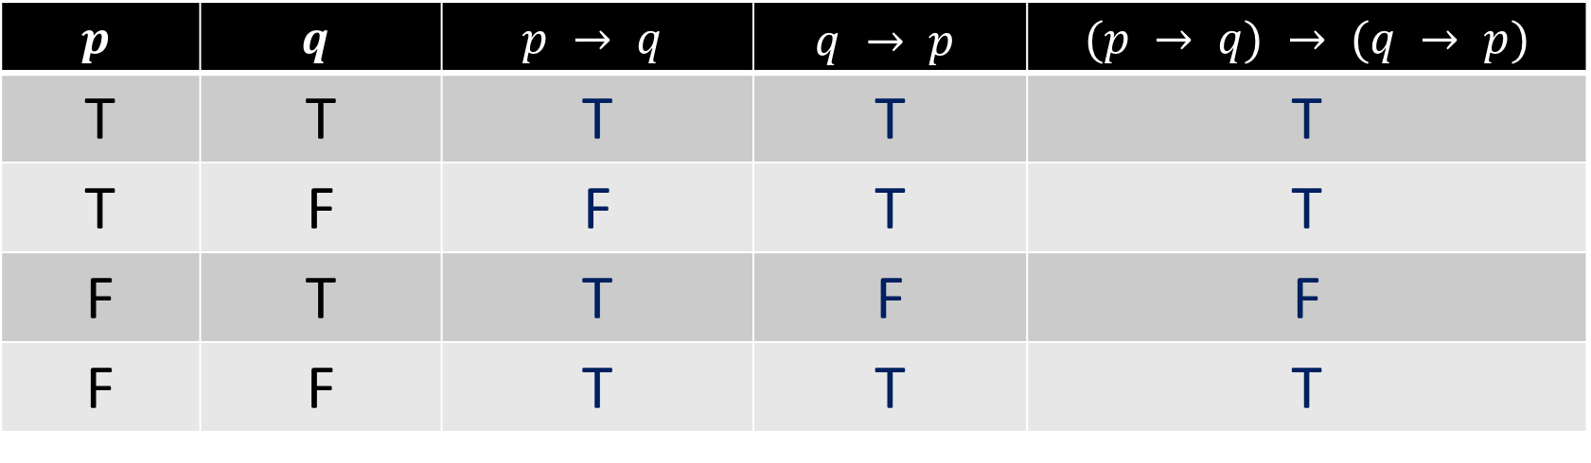

Exercises
33. Construct a truth table for each of these compound propositions.
$(p → q) → (q → p)$
$$p$$ | $$q$$ | $$p → q$$ | $$q → p$$ | $$(p → q) → (q → p)$$
T | T | T | T | T
T | F | F | T | T
F | T | T | F | F
F | F | T | T | T

Slide 35

Exercises
41. Construct a truth table for $(p ↔ q) ↔ (r ↔ s)$.

Slide 36
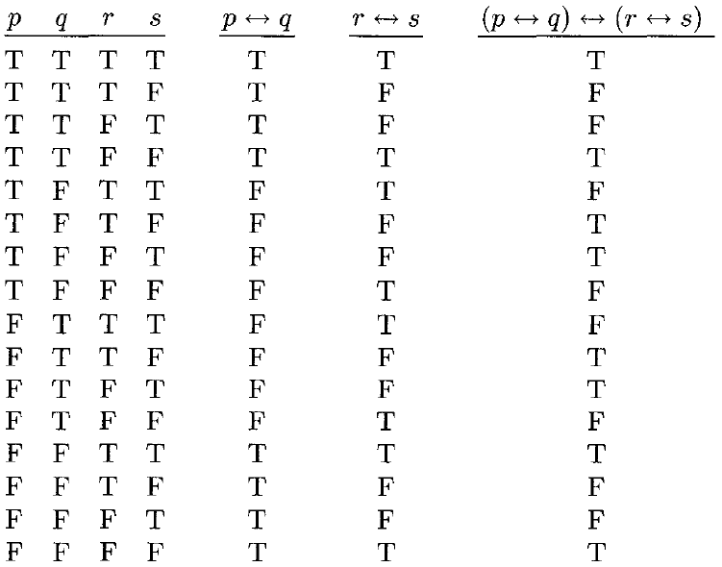
Exercises
41. Construct a truth table for $(p ↔ q) ↔ (r ↔ s)$.

Slide 37

Exercises
42. Explain, without using a truth table, why $(p ∨¬q) ∧ (q ∨¬r) ∧ (r ∨¬p)$ is true when $p, q$, and $r$ have the same truth value and it is false otherwise.

Slide 38

Exercises
42. Explain, without using a truth table, why $(p ∨¬q) ∧ (q ∨¬r) ∧ (r ∨¬p)$ is true when $p, q$, and $r$ have the same truth value and it is false otherwise.
This statement is true if and only if all three clauses,$p ∨¬q, q ∨¬r,$and$r ∨¬p$ are true. Suppose $p, q$, and $r$ are all true. Because each clause has an unnegated variable, each clause is true. Similarly, if $p, q$, and $r$ are all false, then because each clause has a negated variable, each clause is true.
On the other hand, if one of the variables is true and the other two false, then the clause containing the negation of that variable will be false, making the entire conjunction false; and similarly, if one of the variables is false and the other two true, then the clause containing that variable unnegated will be false, again making the entire conjunction false.

Slide 39

Exercises
46. What is the value of $x$ after each of these statements is encountered in a computer program, if $x = 1$ before the statement is reached?
if x + 2 = 3 then x := x + 1
if (x + 1 = 3) OR (2x + 2 = 3) then x := x + 1

Slide 40
Exercises
46. What is the value of $x$ after each of these statements is encountered in a computer program, if $x = 1$ before the statement is reached?
if x + 2 = 3 then x := x + 1 | The condition is true, the statement is executed, so x is incremented and now has the value 2.
if (x + 1 = 3) OR (2x + 2 = 3) then x := x + 1 | The condition is false, the statement is not executed, so x is not incremented and now still has the value 1.

Slide 41
Exercises
In fuzzy logic, a proposition has a truth value that is a number between 0 and 1, inclusive.
A proposition with a truth value of 0 is false and one with a truth value of 1 is true.
Truth values that are between 0 and 1 indicate varying degrees of truth.
For instance, the truth value 0.8 can be assigned to the statement “Fred is happy,” because Fred is happy most of the time.
The truth value 0.4 can be assigned to the statement “John is happy,” because John is happy slightly less than half the time.

Slide 42
Exercises
49. The truth value of the negation of a proposition in fuzzy logic is 1 minus the truth value of the proposition. What are the truth values of the statements “Fred is not happy” and “John is not happy?”

Slide 43
Exercises
49. The truth value of the negation of a proposition in fuzzy logic is 1 minus the truth value of the proposition. What are the truth values of the statements “Fred is not happy” and “John is not happy?”
For "Fred is not happy," the truth value is 1 - 0.8 = 0.2.
For "John is not happy,'' the truth value is 1- 0.4 = 0.6.

Slide 44
Tasks
Section 1 page 12
2
5
9
13
18 (a, b)
19 (c, d)
29
32
34
37
40
43
Section 1 page 12
46 (c, d, e)
47
48
50 fuzzy logic

Slide 45
Content
The Foundations: Logic and Proofs
Propositional Logic
Applications of Propositional Logic
Propositional Equivalences
Predicates and Quantifiers
Nested Quantifiers
Rules of Inference
Introduction to Proofs
Proof Methods and Strategy

Slide 46
Applications of Propositional Logic
Translating English Sentences
System Specifications
Boolean Searches
Logic Puzzles
Logic Circuits

Slide 47

Applications of Propositional Logic
Translating English Sentences
System Specifications
Boolean Searches
Logic Puzzles
Logic Circuits
EXAMPLE 1: How can this English sentence be translated into a logical expression?
“You can access the Internet from campus only if you are a computer science major or you are not a freshman.”
Solution: $$a=\text{“}\text{You} \text{can} \text{access} \text{the} \text{Internet} \text{from} \text{campus}\text{,”}$$
$$b=“You are a computer science major,”$$
$$f=“You are a freshman,”$$
$$“only if” is one way a conditional statement$$
$$a → (c ∨¬f ).$$

Slide 48

Applications of Propositional Logic
Translating English Sentences
System Specifications
Boolean Searches
Logic Puzzles
Logic Circuits
EXAMPLE 3: Express the specification using logical connectives.
“The automated reply cannot be sent when the file system is full”
Solution:
$$p=\text{“}\text{The} \text{automated} \text{reply} \text{can} \text{be} \text{sent}\text{”}$$
$$q=“The file system is full.”$$
$$q →¬p.$$

Slide 49

Applications of Propositional Logic
Translating English Sentences
System Specifications
Boolean Searches
Logic Puzzles
Logic Circuits
EXAMPLE 6: Web Page Searching
Using Boolean searching to find Web pages about universities in New Mexico, we can look for pages matching $NEW AND MEXICO AND UNIVERSITIES.$
To find pages that deal with universities in New Mexico or Arizona, we can search for pages matching $(NEW AND MEXICO OR ARIZONA) AND UNIVERSITIES.$
What are Google Search Operators?

Slide 50
Applications of Propositional Logic
Translating English Sentences
System Specifications
Boolean Searches
Logic Puzzles
Logic Circuits
EXAMPLE 7:
An island that has two kinds of inhabitants, knights, who always tell the truth, and their opposites, knaves, who always lie. You encounter two people A and B. What are A and B if A says “B is a knight” and B says “The two of us are opposite types?”
Solution: …TASK
Example 8: TASK … read and comprehend

Slide 51
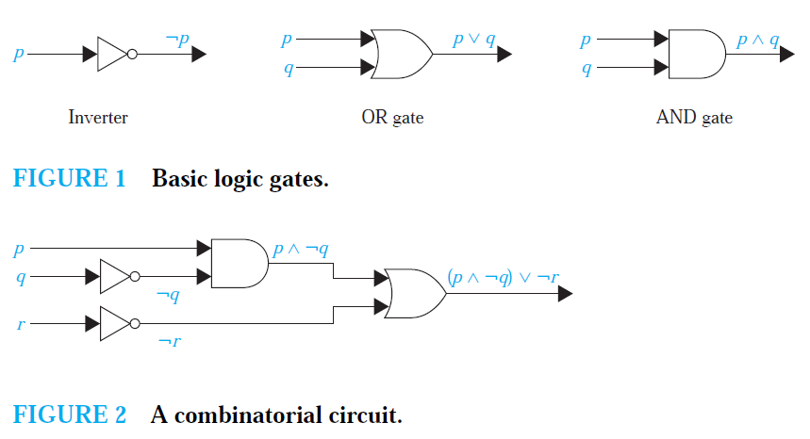
Applications of Propositional Logic
Translating English Sentences
System Specifications
Boolean Searches
Logic Puzzles
Logic Circuits
EXAMPLE 9:
Determine the output for the combinatorial circuit in Figure 2.

Slide 52

Exercises
1. You cannot edit a protected Wikipedia entry unless you are an administrator. Express your answer in terms of $e: “You can edit a protected Wikipedia entry”$ and $a: “You are an administrator.”$

Slide 53

Exercises
You cannot edit a protected Wikipedia entry unless you are an administrator. Express your answer in terms of $e: “You can edit a protected Wikipedia entry”$ and $a: “You are an administrator.”$
$\text{e} → \text{a}$ (you can edit a protected Wikipedia entry if you are an admin)
or
$¬a →¬e$ (if you are not an admin, you cannot edit a Wikipedia entry)

Slide 54

Exercises
3. You can graduate only if you have completed the requirements of your major and you do not owe money to the university and you do not have an overdue library book. Express your answer in terms of $g: “You can graduate,”$ $m: “You owe money to the university,”$ $r: “You have completed the requirements of your major,”$ and $b: “You have an overdue library book.”$

Slide 55

Exercises
3. You can graduate only if you have completed the requirements of your major and you do not owe money to the university and you do not have an overdue library book. Express your answer in terms of $g: “You can graduate,”$ $m: “You owe money to the university,”$ $r: “You have completed the requirements of your major,”$ and $b: “You have an overdue library book.”$
$$g → (r∧(¬m)∧(¬b)).$$

Slide 56

Exercises
8. Express these system specifications using the propositions
$p “The user enters a valid password,”$ $q “Access is granted,”$ and
$r “The user has paid the subscription fee”$ and logical connectives (including negations).
Sentence | Proposition
“The user has paid the subscription fee, but does not enter a valid password.”
“Access is granted whenever the user has paid the subscription fee and enters a valid password.”
“Access is denied if the user has not paid the subscription fee.”
“If the user has not entered a valid password but has paid the subscription fee, then access is granted.”

Slide 57
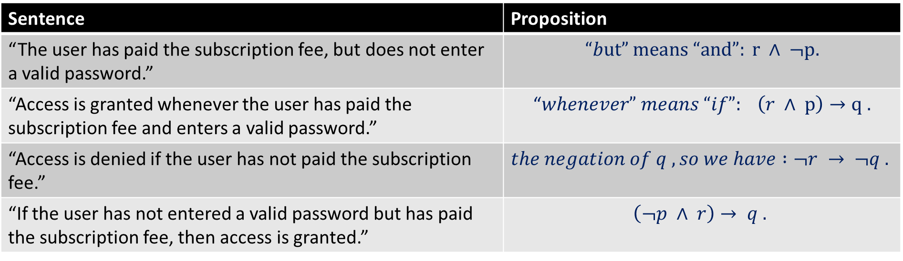
Exercises
8. Express these system specifications using the propositions
$p “The user enters a valid password,”$ $q “Access is granted,”$ and
$r “The user has paid the subscription fee”$ and logical connectives (including negations).
Sentence | Proposition
“The user has paid the subscription fee, but does not enter a valid password.” | $$“but” means “and”: r ∧ ¬p.$$
“Access is granted whenever the user has paid the subscription fee and enters a valid password.” | “$whenever” means “if”: \left(r ∧ p\right)→q .$
“Access is denied if the user has not paid the subscription fee.” | $$the negation of q , so we have :¬r → ¬q .$$
“If the user has not entered a valid password but has paid the subscription fee, then access is granted.” | $$\left(¬p ∧ r\right)→ q .$$

Slide 58

Exercises
Exercises 19–23 relate to inhabitants of the island of knights and knaves created by Smullyan, where knights always tell the truth and knaves always lie. You encounter two people, A and B. Determine, if possible, what A and B are if they address you in the ways described. If you cannot determine what these two people are, can you draw any conclusions?
23. $A$ says $“At least one of us is a knave”$ and $B$ says nothing.

Slide 59

Exercises
23. $A$ says $“At least one of us is a knave”$ and $B$ says nothing.
If $A$ is a knight, then he is telling the truth, in which case $B$ must be a knave. Since $B$ said nothing, that is certainly possible. If $A$ is a knave, then he is lying, which means that his statement that at least one of them is a knave is false; hence they are both knights. That is a contradiction. So we can conclude that $A$ is a knight and $B$ is a knave.

Slide 60
Exercises
24. A says “The two of us are both knights” and B says “A is knave.”

Slide 61


Exercises
24. $A$ says “The two of us are both knights” and $B$ says “$A$ is knave.”
If $A$ is a knight, then his statement that both of them are knights is true, and both will be telling the truth.
But that is impossible, because $B$ is asserting otherwise (that $A$ is a knave). If$A$is a knave, then $B$’s assertion is true, so he must be a knight, and $A$'s assertion is false, as it should be. Thus, we conclude that $A$ is a knave and $B$ is a knight.

Slide 62

Exercises
Exercises 24–31 relate to inhabitants of an island on which there are three kinds of people: knights who always tell the truth, knaves who always lie, and spies who can either lie or tell the truth. You encounter three people, A, B, and C. You know one of these people is a knight, one is a knave, and one is a spy. Each of the three people knows the type of person each of other two is.
29. $A$ says “I am the knight,” $B$ says “I am the knave,” and $C$ says “B is the knight.”

Slide 63

Exercises
29. $A$ says “I am the knight,” $B$ says “I am the knave,” and $C$ says “B is the knight.”
Neither the knight nor the knave would say that he is the knave, so $B$ must be the spy. Therefore $C$ is lying and must be the knave, and $A$ is therefore the knight (and told the truth).

Slide 64

Exercises
30. $A$ says “I am the knave,” $B$ says “I am the knave,” and $C$ says “I am the knave.”

Slide 65
Exercises
30. $A$ says “I am the knave,” $B$ says “I am the knave,” and $C$ says “I am the knave.”
There is no solution, because neither a knight nor a knave would ever claim to be the knave.

Slide 66
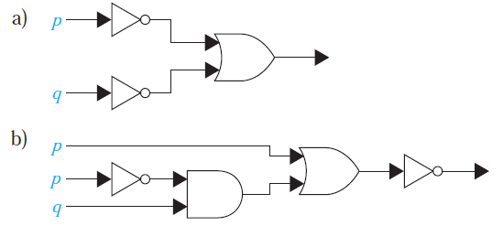
Exercises
44. Find the output of each of these combinatorial circuits.

Slide 67


Exercises
44. Find the output of each of these combinatorial circuits.
$$(¬p) ∨ (¬q).$$
$$¬(p ∨ ((¬p) ∧ q)))$$

Slide 68

Exercises
47. Construct a combinatorial circuit using inverters, OR gates, and AND gates that produces the output $((¬p ∨¬r)∧¬q) ∨ (¬p ∧ (q ∨ r))$
from input bits $p, q$, and $r$.

Slide 69
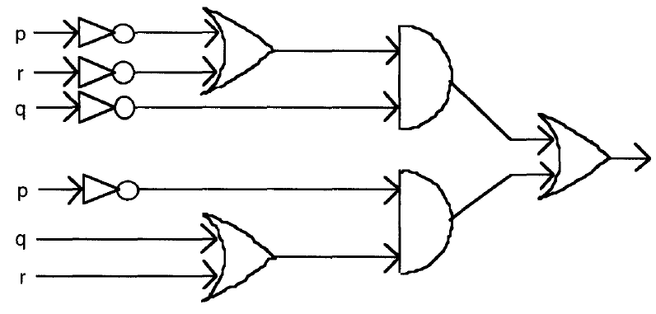
Exercises
47. Construct a combinatorial circuit using inverters, OR gates, and AND gates that produces the output $((¬p ∨¬r)∧¬q) ∨ (¬p ∧ (q ∨ r))$
from input bits $p, q$, and $r$.

Slide 70
TASKS
Section 2
2
4
25
26
27
28
31
45
46

